Slide 1
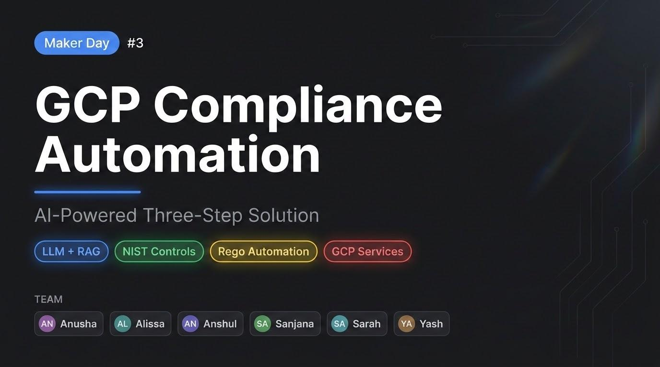

Slide 2
The Problem
Enterprises cannot systematically map, implement, and continuously verify compliance controls on GCP — making onboarding manual, fragmented, and slow.
CURRENT PROCESS
PROBLEMS
01
Starting Point
Mapping Gap
~40%
Org decides to integrate with GCP
Root Cause: No standardized framework exists to map regulatory controls to GCP services.
Impact: 60% of GCP services have no compliance definition and are handled manually.
GCP mapped
02
Onboarding & Channel
Self-service, professional services, or white glove
Automated Evidence Gap
0%
03
Foundational Services
Root Cause: No mechanism exists to automatically collect audit evidence from GCP.
Configure 25-30 core GCP services
Impact: Teams screenshot consoles into spreadsheets, which is unreliable and not reusable.
Automated
04
Audit the Flow
Monitoring Gap
1×/yr
3-line defense: execute, monitor, gather
Root Cause: Controls are validated only at audit time and never on a continuous basis.
↑ Where it breaks
Audit cadence
05
Create Mapping Spreadsheet
Impact: Configuration drift goes undetected for months, creating compounding compliance risk.
Manually map NIST controls to GCP services in a spreadsheet
For Most
Low Coverage of Rego, Policy-as-Code
06
Check Logs & Screenshots
Root Cause: Generating Rego policies per control-service pair at enterprise scale is not feasible.
Check logs via Screenwalk and capture screenshots as audit evidence
Impact: Compliance controls are never enforced as code and exist only as static documents.
Enterprises

Slide 3
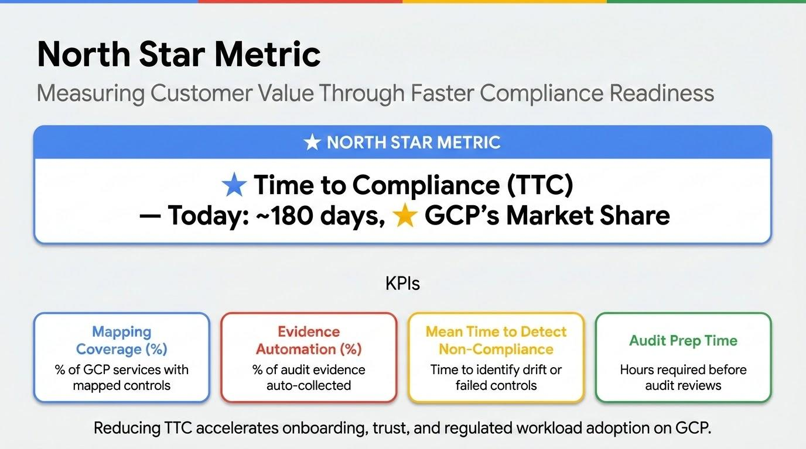

Slide 4
GCP Compliance Automation
An AI-Powered Three-Step Solution
01
NOW
02
NOW
03
FUTURE
Control Mapping
Monitoring & Evidence
Rego Automation
NIST → GCP Services
Automated Audit Flow
Policy-as-Code Generation
RAG-powered agent maps every NIST control to relevant GCP services, replacing manual rule-writing with intelligent LLM reasoning.
Agent defines, executes and stores test cases per control - collecting audit evidence on pass and triggering alerts on failure.
Auto-generate OPA/Rego policies from mapped controls for continuous, enforcement-as-code across all GCP resources.
Powered by LLMs + RAG · Reduces manual effort · Continuous compliance

Slide 5
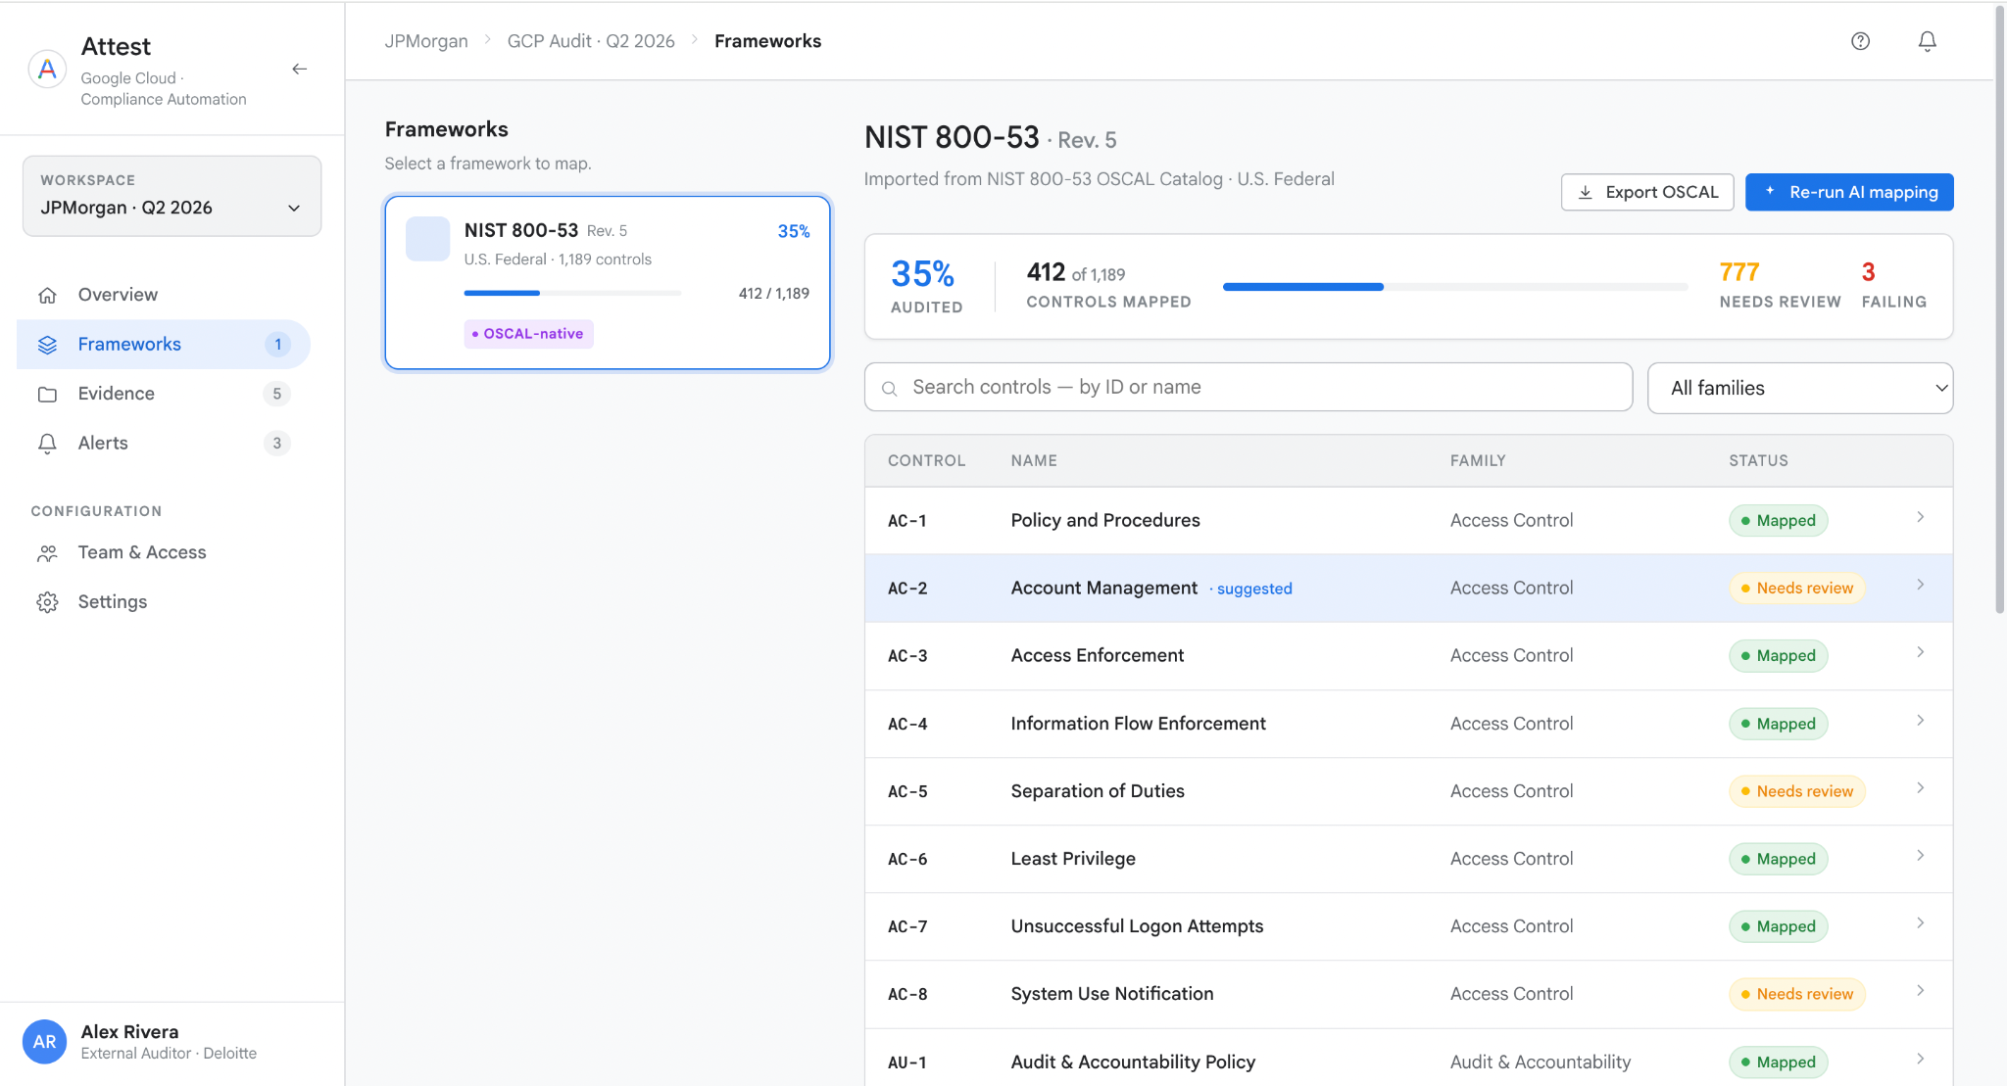
Frontend Experience for Auditors
https://claude.ai/design/p/019de1aa-0735-7f35-928c-4e3b5d3af7d5?file=Attest+Compliance+Prototype.html&via=share

Slide 6
Backend Agent Workflow
Architecture - Mutli-Agent System Demo Link - Backend Example Input -
Audit Logging and Monitoring NIST SP 800-53
audit logging
The system must generate, retain, and review audit logs for privileged administrator activity, including changes to access permissions and security-relevant configuration settings.
Sources: https://developers.google.com/knowledge/mcp https://github.com/oscal-club/awesome-oscal
https://gemara.openssf.org/.

Slide 7
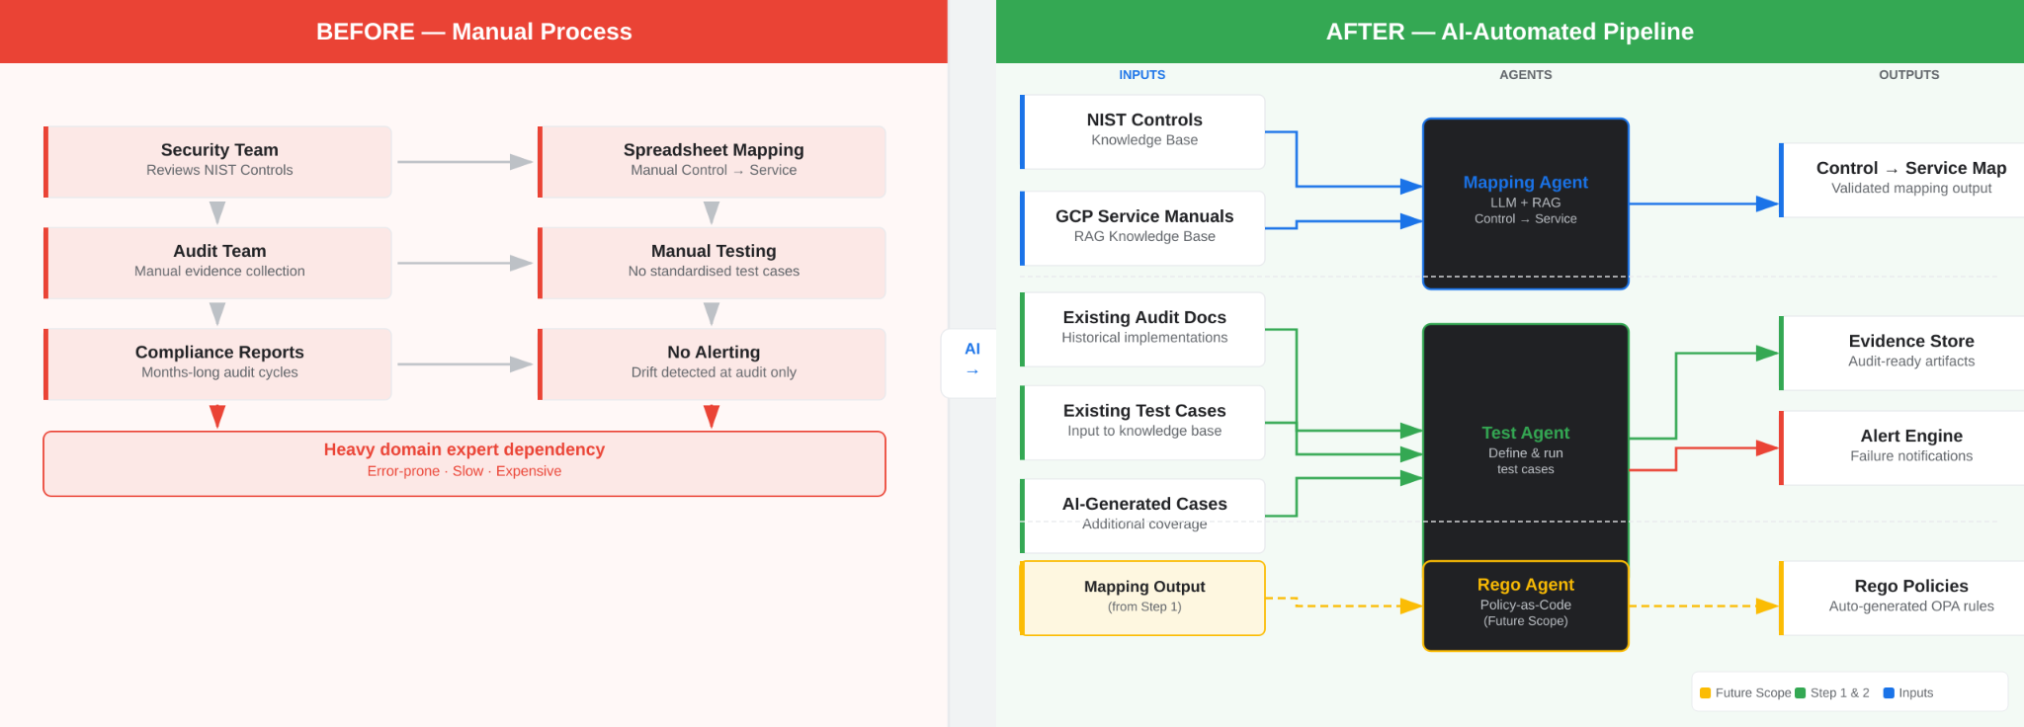
Before vs After
Manual Compliance Process → AI-Automated Pipeline
Notes:
“This slide contrasts the current manual compliance workflow with our AI-automated pipeline.”
“On the left is the ‘before’ state—highly manual, fragmented, and slow.”
“On the right is the ‘after’ state—an integrated, agent-driven system that automates mapping, testing, and monitoring.”
Left Side — BEFORE (Manual Process)
“Today, the process starts with the security team manually reviewing NIST controls.”
“Then the audit team collects evidence manually, often across multiple systems.”
“This feeds into compliance reports, which typically take months to produce.”
“On the execution side:
Controls are mapped using spreadsheets
Testing is manual and inconsistent
There is no real-time alerting—issues are only caught during audits”
“The key takeaway here is:
Heavy reliance on domain experts
High error rates
Slow turnaround
Expensive to scale”
“So fundamentally, the current system is reactive, not proactive.”
“Now let’s look at how we redesign this using AI.”
Inputs Layer
“We start by centralizing inputs into knowledge bases:
NIST controls
GCP service documentation
Existing audit docs and test cases
Plus AI-generated test cases for broader coverage”
Agents Layer
“We introduce specialized AI agents, each responsible for a key function.”
Mapping Agent
“Uses LLM + retrieval (RAG) to automatically map controls to services”
“Eliminates spreadsheet-based mapping and improves consistency”
Test Agent
“Defines and runs test cases”
“Combines existing + AI-generated cases for better coverage”
“Continuously validates compliance instead of periodic checks” Outputs Layer
“The system produces three key outputs:
Validated control-to-service mappings
Audit-ready evidence stored centrally
Real-time alerts for failures”
Key Improvements
“Compared to the manual process, this approach:
Reduces dependency on human experts
Speeds up compliance cycles dramatically
Improves accuracy and coverage
Enables real-time monitoring instead of delayed audits”
“In short, we move from a manual, audit-driven model to an automated, continuous compliance system powered by AI agents.”

Slide 8
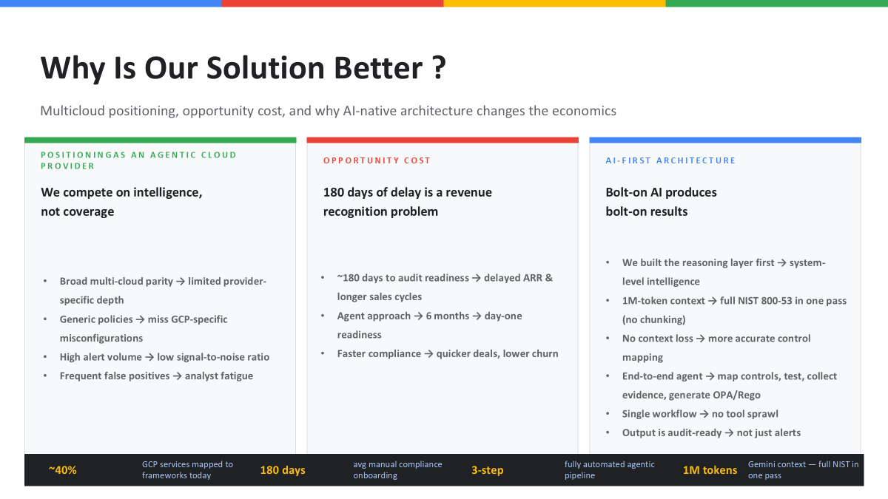

Slide 9
Risks
Two risks associated with our solution
01
02
Hallucinated mappings
Unclear liability
Can create silent compliance gaps
when AI-assisted audits go wrong erodes trust with auditors and regulated customers.
Human-in-the-loop approval on every AI mapping, with confidence scores and golden-set evaluation before frameworks go live.
Position the tool as decision-support, not decision-making - every action attributed to a named auditor, AI outputs labeled as drafts until approved.
Powered by LLMs + RAG · Reduces manual effort · Continuous compliance

Slide 10
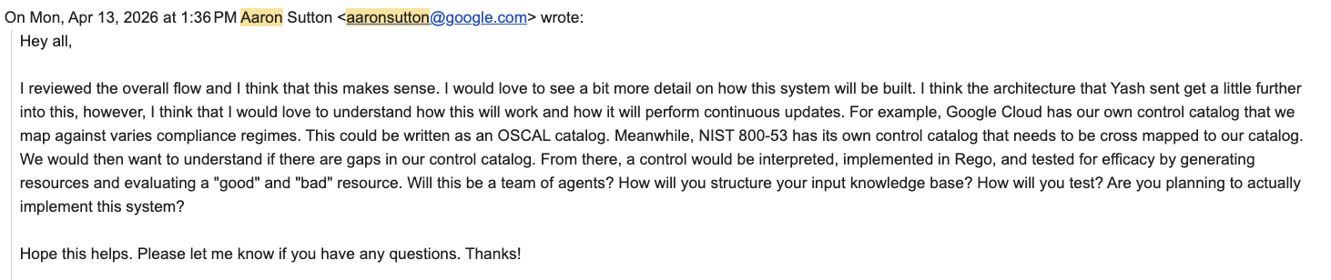
Sources - Correspondance with Aaron

Slide 11
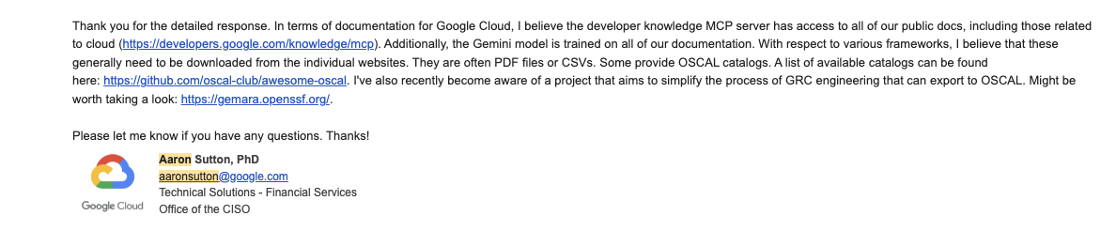
Sources - Correspondance with Aaron

Slide 12
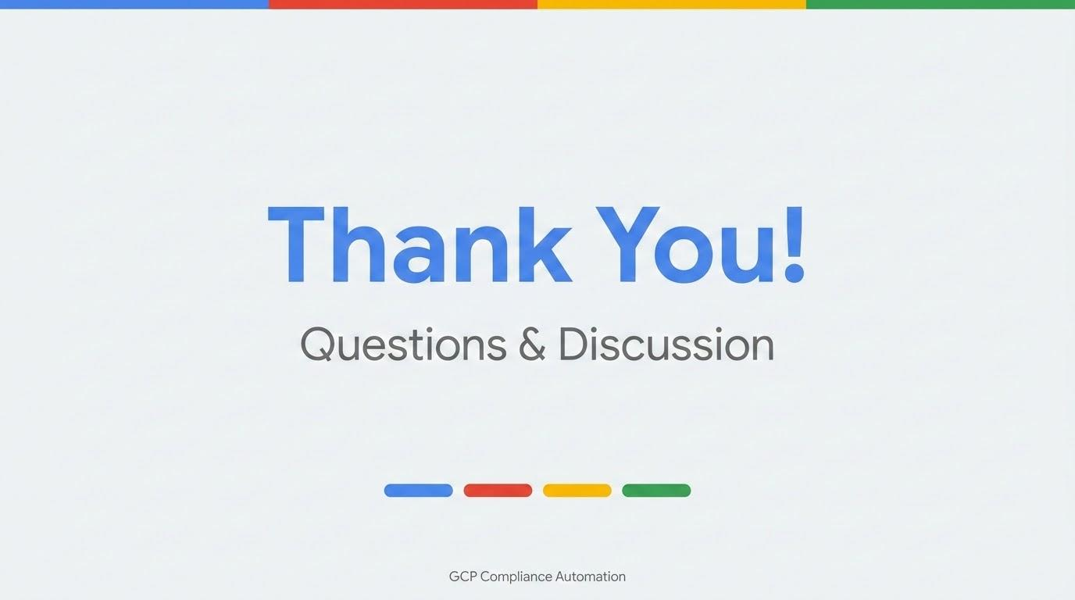

Slide 13
Why our Solution is Better ?
Our Value Prop compared to AWS, Prisma, Azure
Why is it needed now for google ?
Multicloud platforms
What is the opp cost ?
AI focused
Our Value Prop vs. AWS, Prisma Cloud & Azure AWS Security Hub, Azure Defender for Cloud, and Prisma Cloud all offer compliance monitoring within their own ecosystems — but none combine automated control mapping, LLM-powered evidence collection, and auto-generated OPA/Rego policy in a single, integrated pipeline. Our solution delivers all three steps in one agentic workflow, purpose-built for GCP, at a fraction of the manual overhead.
Why Is It Needed Now for Google? GCP currently has no native, end-to-end compliance automation layer — only ~40% of GCP services are mapped to regulatory frameworks today, and evidence collection is entirely manual. As GCP accelerates enterprise adoption, customers need a compliance story that is fast, auditable, and continuous; without it, GCP loses deals to AWS and Azure at the onboarding stage.
Multicloud Platforms While Prisma Cloud covers multicloud environments, it is highly priced, generates excessive alerts, and is difficult for human operators to validate — and still requires manual rule authoring. Our solution is GCP-native but designed with the same multicloud integration surface, giving enterprises a cleaner, more intelligent alternative without vendor lock-in overhead.
Opportunity Cost Every day without automated compliance mapping costs enterprises roughly 180 days of manual onboarding time, delayed audit readiness, and undetected configuration drift. For Google Cloud, the opportunity cost is measured in enterprise contracts lost to AWS and Azure where automated compliance tooling is already an expected baseline.

